Slide 1
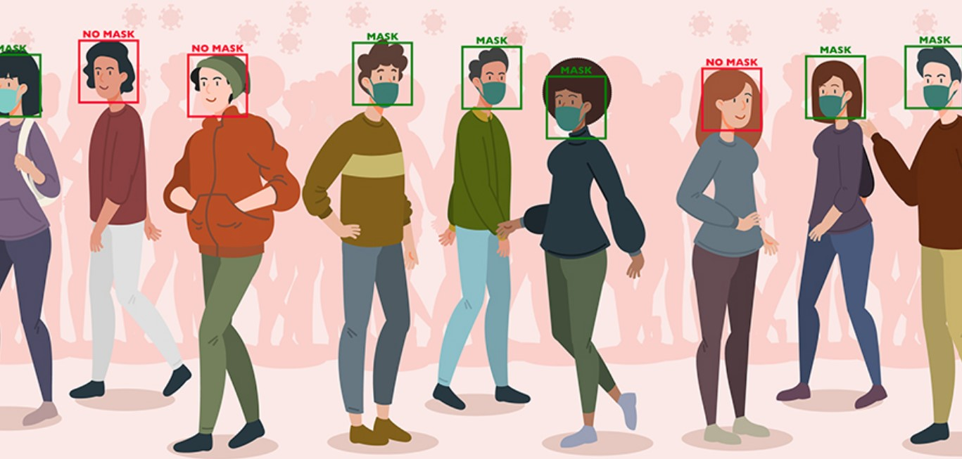
Face Mask Detection
Deep Learning Final Project
By
Safoura Janosepah and Azadeh Ghaffari

Slide 2
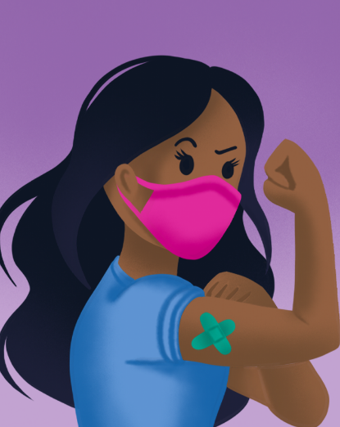
Objective
The novel COVID-19 virus has forced us all to rethink how we live our everyday lives while keeping ourselves and others safe. Face masks have emerged as a simple and effective strategy for reducing the virus’s threat and also, application of face mask detection system are now in high demand for transportation means, densely populated areas, residential districts, large-scale manufacturers and other enterprises to ensure safety. Therefore, the goal of this project is to develop a face mask detector using deep learning.

Slide 3
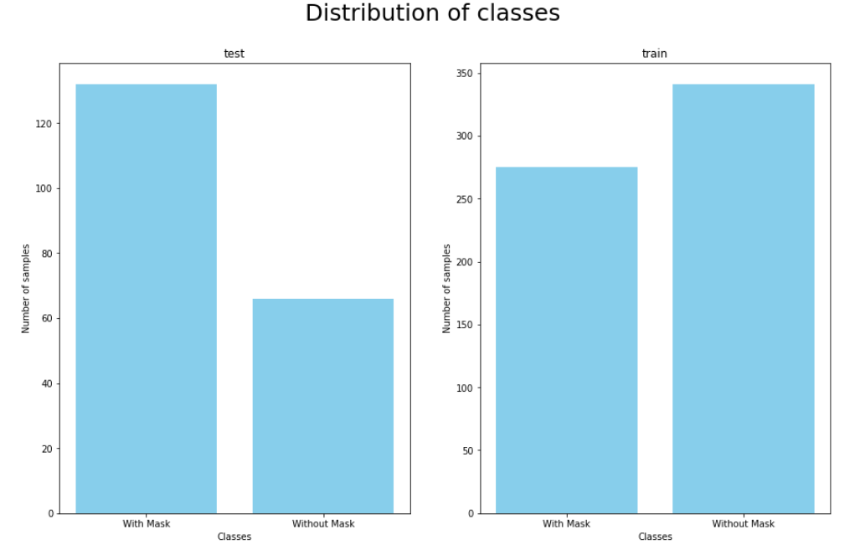
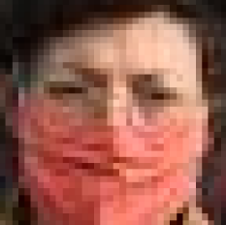
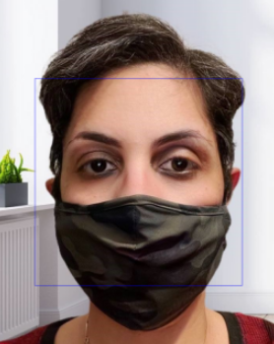
Data preparation
We got the most images from Kaggle then we realized they are not all in good quality so we added our images also to the data then we
1. Resized the input image (128 x 128)
2. Scaled / Normalized images
And set the train and test groups

Slide 4
Choosing and Training Deep Learning Models
In this project, we try to implement multiple Deep Learning models including:
ConvNet - most commonly applied to analyzing visual imagery ( we trained the model 3 times with adding layers each time)
Inception V3 : is a convolutional neural network for assisting in image analysis and object detection
VGG19 : is a variant of VGG model which in short consists of 19 layers
DenseNet201: is a convolutional neural network that is 201 layers deep

Slide 5
Continue ..
MobileNet : are based on a streamlined architecture that uses depth-wise separable convolutions to build light weight deep neural networks
Residual Convolutional Neural Networks 50 : ResNet is one of the usefull models for image recognition tasks
YOLO5: This is because we’re limiting the computer vision pipeline to a single step, since object detectors are trained to detect a: Bounding box and a Corresponding label

Slide 6
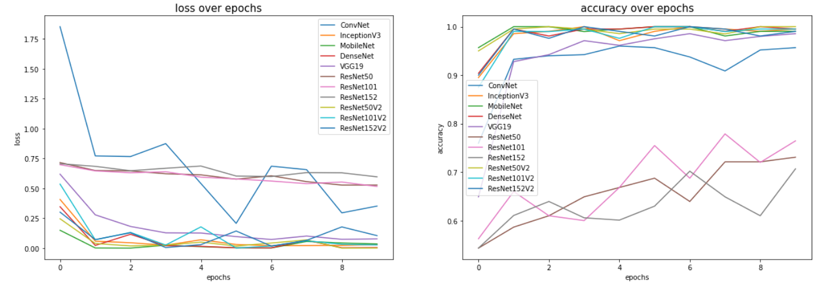
Result
MobileNet , RestNet50V2 , DenseNet, VGG19 ,RestNet152V2
ConvNet, RestNet101V2, RestNet152 and RestNet50

Slide 7
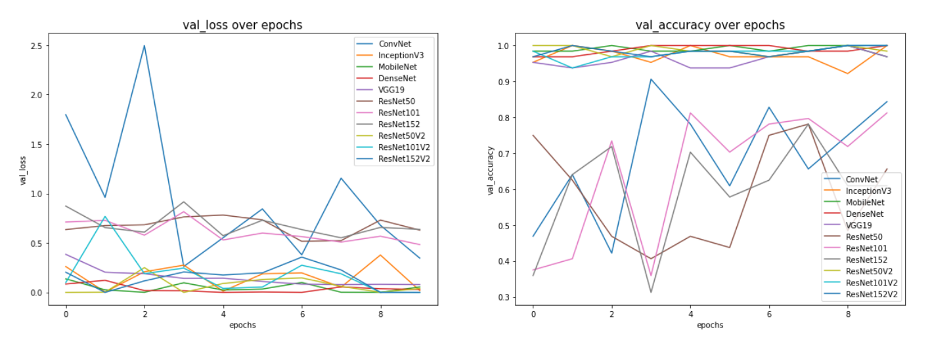
Continue ..
We can see after epoch 7 we got high accuracy for most of the models and low loss.

Slide 8
Test the models
Test the last model with new data , try to detect mask on face using OpenCV
Test models with another source of data to get the accuracy based on prediction
Based on the result that we got after training we want to run the test on the top models
VGG19
RestNet152V2
RestNet50V2

Slide 9
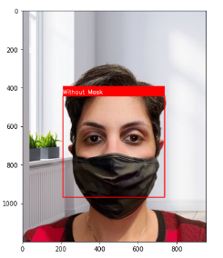
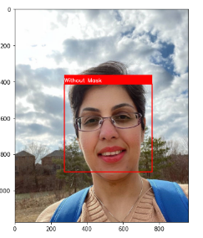
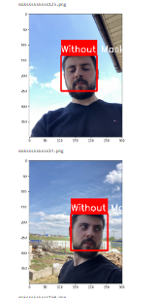
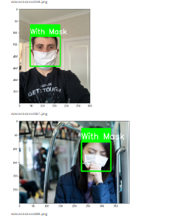
Part of testing
VGG19

Slide 10
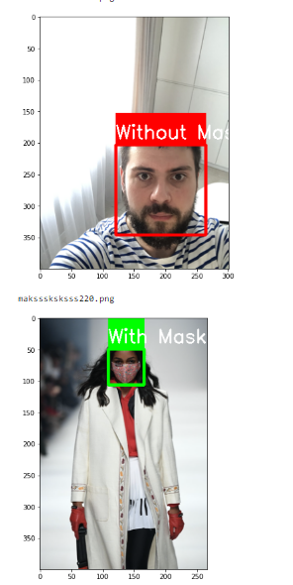
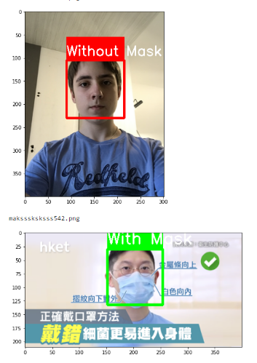
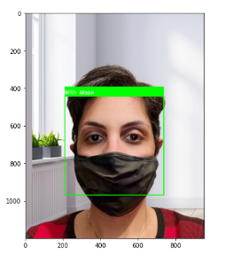
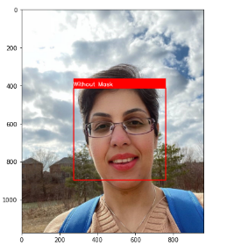
Continue ..
RestNet152V2

Slide 11
Continue
Based on the test that we run and predict our images
"RestNet50V2"we got %63 accuracy ->
"VGG19" we got %94 accuracy

Slide 12
Use Cases
Here are a few use cases where this mask detection technology could be leveraged.
Airports: The Face Mask Detection System could be used at airports to detect travelers without masks. Face data of travelers can be captured in the system at the entrance. If a traveler is found to be without a face mask, their picture is sent to the airport authorities so that they could take quick action.
Hospitals: Using Face Mask Detector System, Hospitals can monitor if quarantined people required to wear a mask are doing so or not. The same holds good for monitoring staff on duty too.
Offices & Working Spaces: The Face Mask Detection System can be used at office premises to ascertain if employees are maintaining safety standards at work. It monitors employees without masks and sends them a reminder to wear a mask.
Government: To limit the spread of coronavirus, the police could deploy the face mask detector on its fleet of surveillance cameras to enforce the compulsory wearing of face masks in public places.

Slide 13
References
Kaggle
https://www.kaggle.com/andrewmvd/face-mask-detection
https://www.kaggle.com/ashishjangra27/face-mask-12k-images-dataset
https://www.kaggle.com/niharika41298/withwithout-mask
https://www.irjet.net/archives/V7/i8/IRJET-V7I8530.pdf
https://www.ideas2it.com/blogs/face-mask-detector-using-deep-learning-pytorch-and-computer-vision-opencv/

